Slide 1

Sequence to Sequence and Attention
Presented by:
Elizer Ponio Jr.
Department of Computer Science
College of Computing and Information Technologies

Slide 2
Outline
Sequence to Sequence
Encode-Decode Framework
The Problem of Fixed Representation
Attention

Slide 3
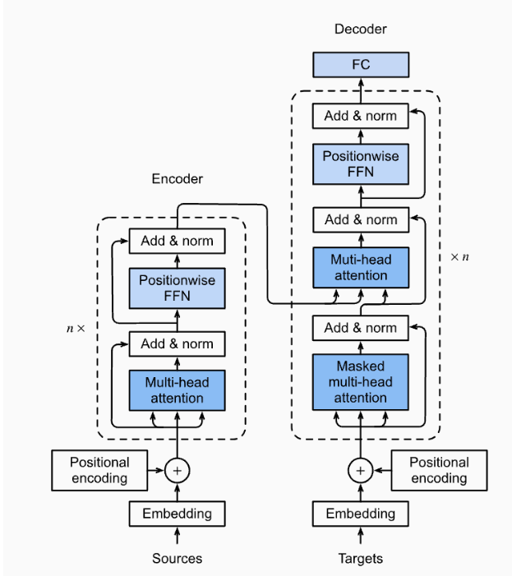
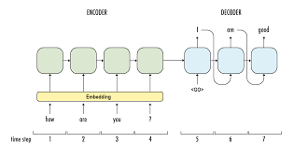
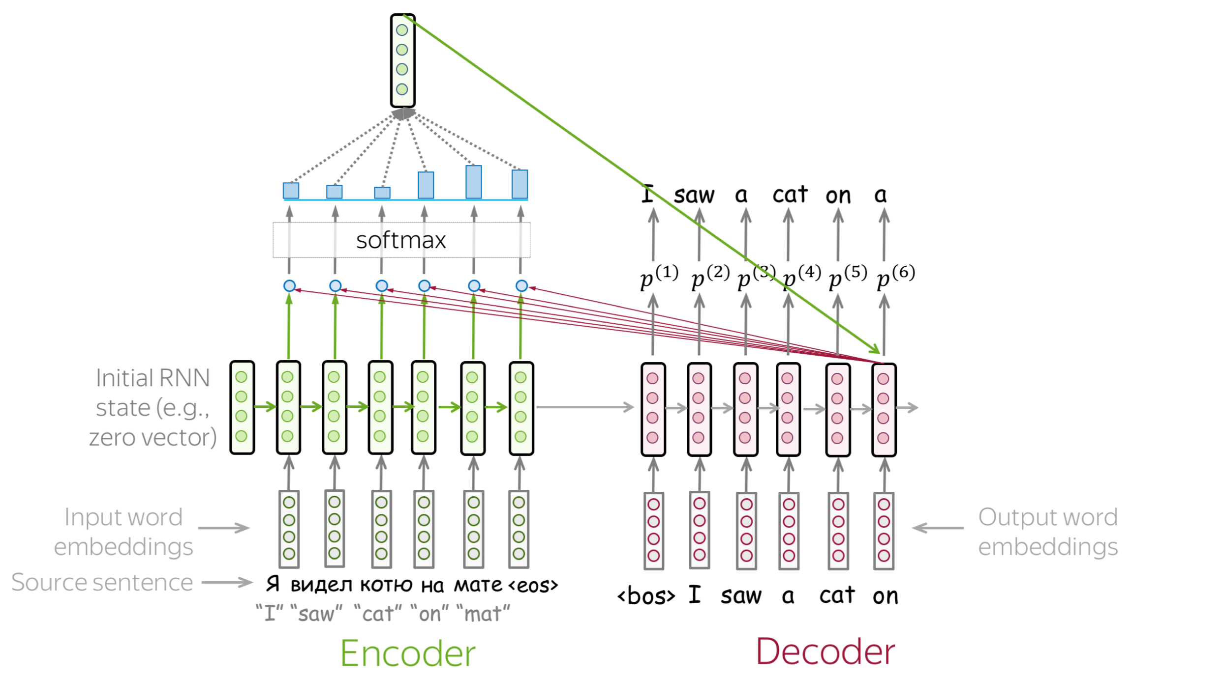
Road to Transformers
Sequence to Sequence
Attention
Transformers
Throughout this lesson, we will talk about Sequence to Sequence models and Attention which are stepping stones to learning about Transformers, which is the currently the state-of-the-art architecture

Slide 4
Machine Translation
The most popular sequence-to-sequence task is translation: usually, from one natural language to another.
In the last couple of years, commercial systems became surprisingly good at machine translation - check out, for example, Google Translate

Slide 5
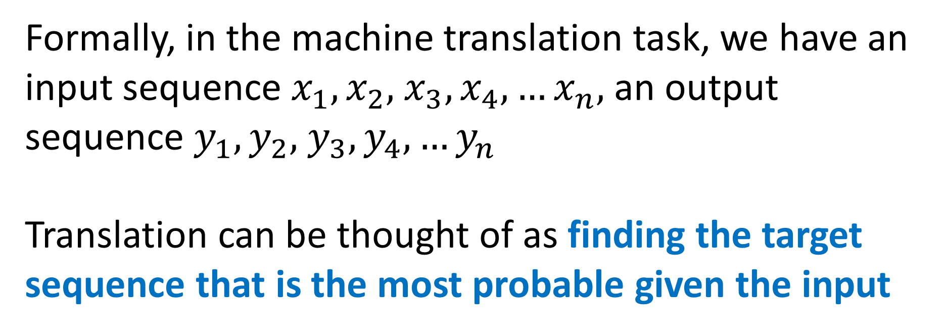
Sequence to Sequence Basics
Formally, in the machine translation task, we have an input sequence $x_{1},x_{2},$ $x_{3}, x_{4}, …x_{n},$an output sequence $y_{1},y_{2},$ $y_{3}, y_{4}, …y_{n}$
Translation can be thought of as finding the target sequence that is the most probable given the input

Slide 6

Sequence to Sequence Basics
If you are bilingual and can translate between languages easily, you have an intuitive feeling of
$p(y|x)$
and can say something like "...well, this translation is kind of more natural for this sentence".

Slide 7
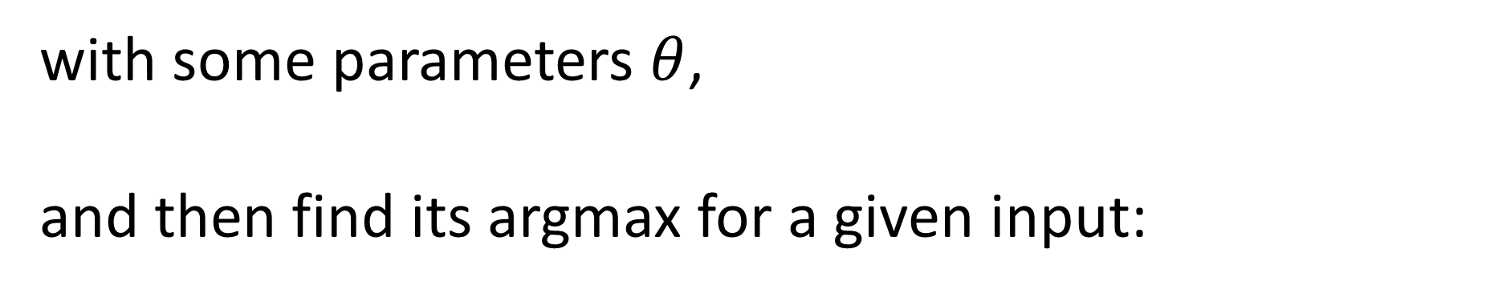
Sequence to Sequence Basics
But in machine translation, we learn a function
$p(y|x, θ)$
with some parameters $θ$,
and then find its argmax for a given input:
$y^{′}=argmax p(y|x, θ)$

Slide 8
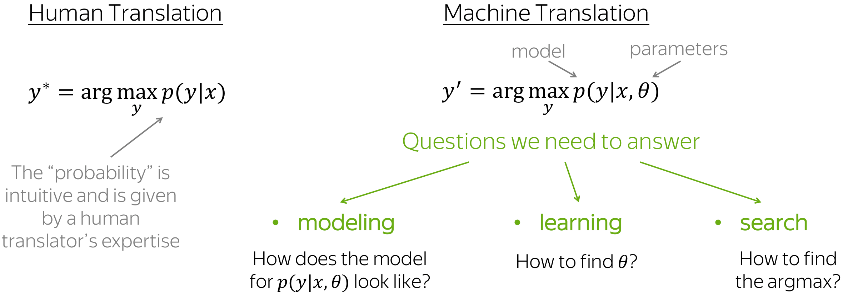

Slide 9
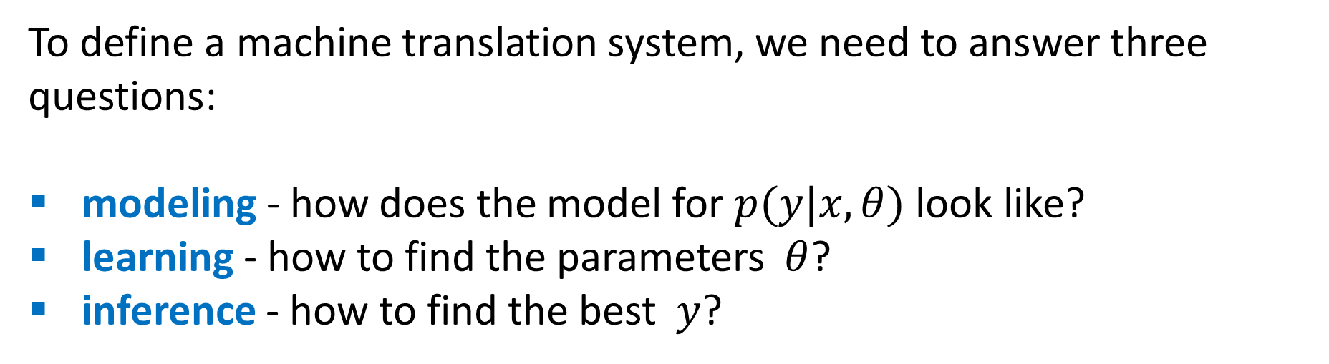
Sequence to Sequence Basics
To define a machine translation system, we need to answer three questions:
modeling - how does the model for $p(y|x, θ)$ look like?
learning - how to find the parameters $θ$?
inference - how to find the best $y$?

Slide 10
Encoder-Decoder Framework
Encoder-decoder is the standard modeling paradigm for sequence-to-sequence tasks. This framework consists of two components:
Encoder
Reads source sequence and produces its representation
Decoder
Uses source representation from the encoder to generate the target sequence.

Slide 11
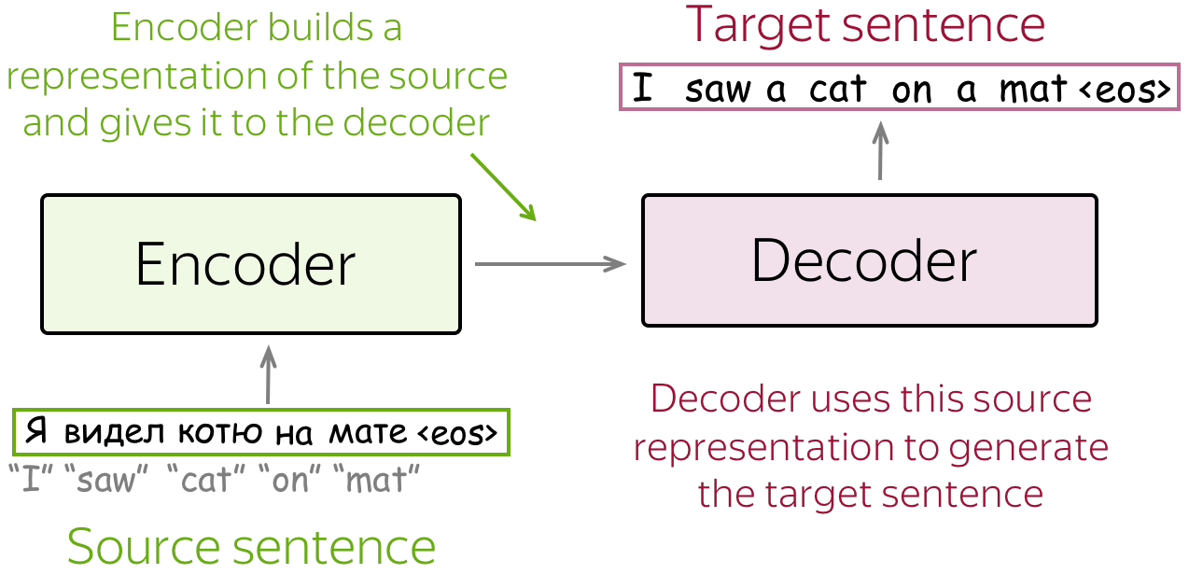

Slide 12
Encoder-Decoder Pipeline
Feed source and previously generated target words into a network;
Get vector representation of context (both source and previous target) from the networks decoder;
From this vector representation, predict a probability distribution for the next token.

Slide 13
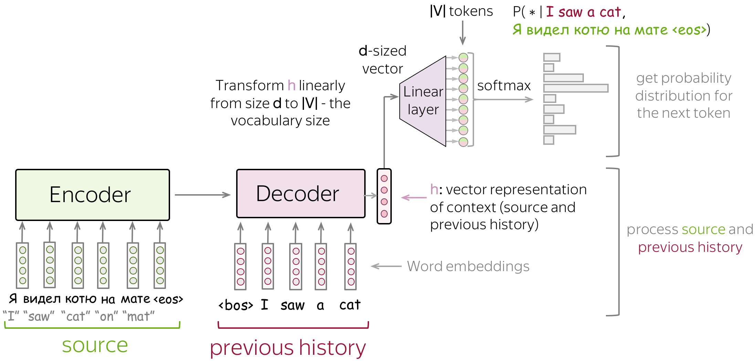

Slide 14
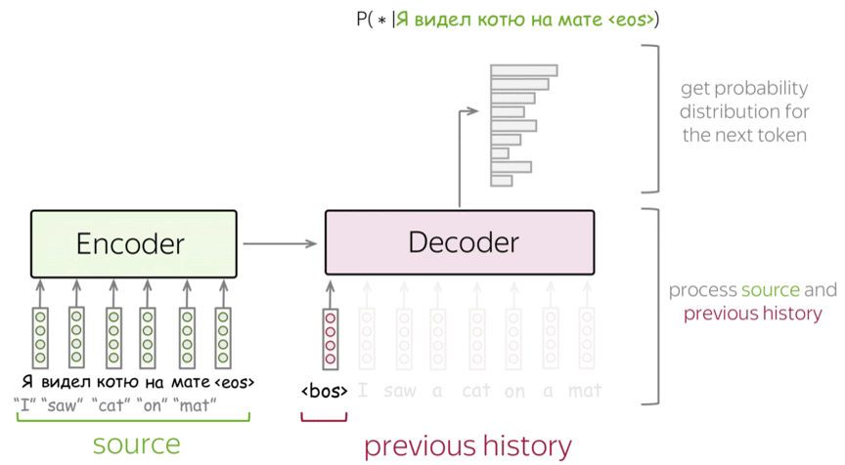

Slide 15
Encoder-Decoder Pipeline
Feed source and previously generated target words into a network
Get vector representation of context (both source and previous target) from the networks decoder.
From this vector representation, predict a probability distribution for the next token.

Slide 16
The Simplest Model: Two RNNs for Encoder and Decoder
The simplest encoder-decoder model consists of two RNNs (LSTMs), one for the encoder and another for the decoder.
Encoder RNN reads the source sentence, and the final state is used as the initial state of the decoder RNN.
The hope is that the final encoder state "encodes" all information about the source, and the decoder can generate the target sentence based on this vector.

Slide 17
The Simplest Model: Two RNNs for Encoder and Decoder
The simplest encoder-decoder model consists of two RNNs (LSTMs): one for the encoder and another for the decoder.
Encoder RNN reads the source sentence, and the final state is used as the initial state of the decoder RNN.
The hope is that the final encoder state "encodes" all information about the source, and the decoder can generate the target sentence based on this vector.

Slide 18
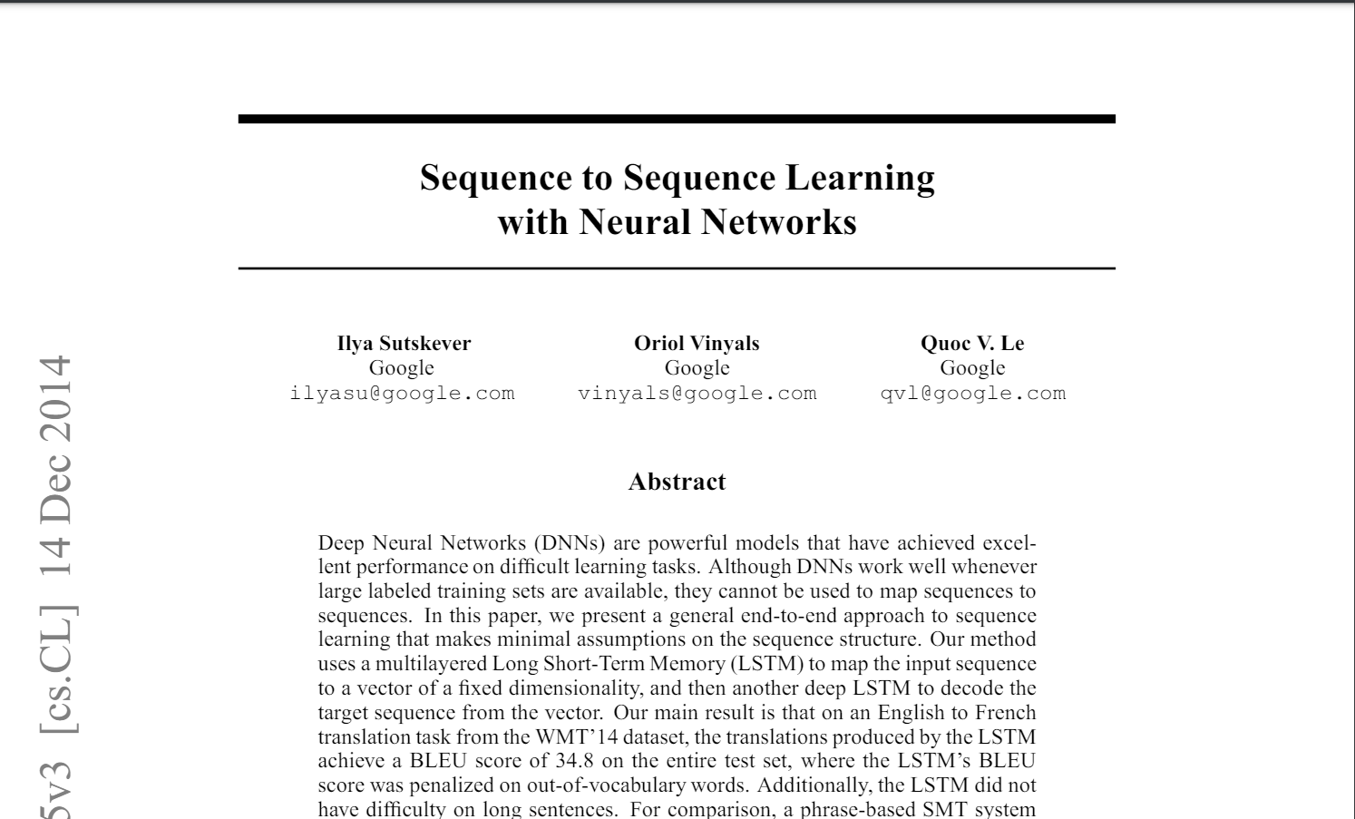
The Simplest Model: Two RNNs for Encoder and Decoder
One of the first attempts to solve sequence-to-sequence tasks using neural networks by Sutskever et.al
https://arxiv.org/pdf/1409.3215

Slide 19
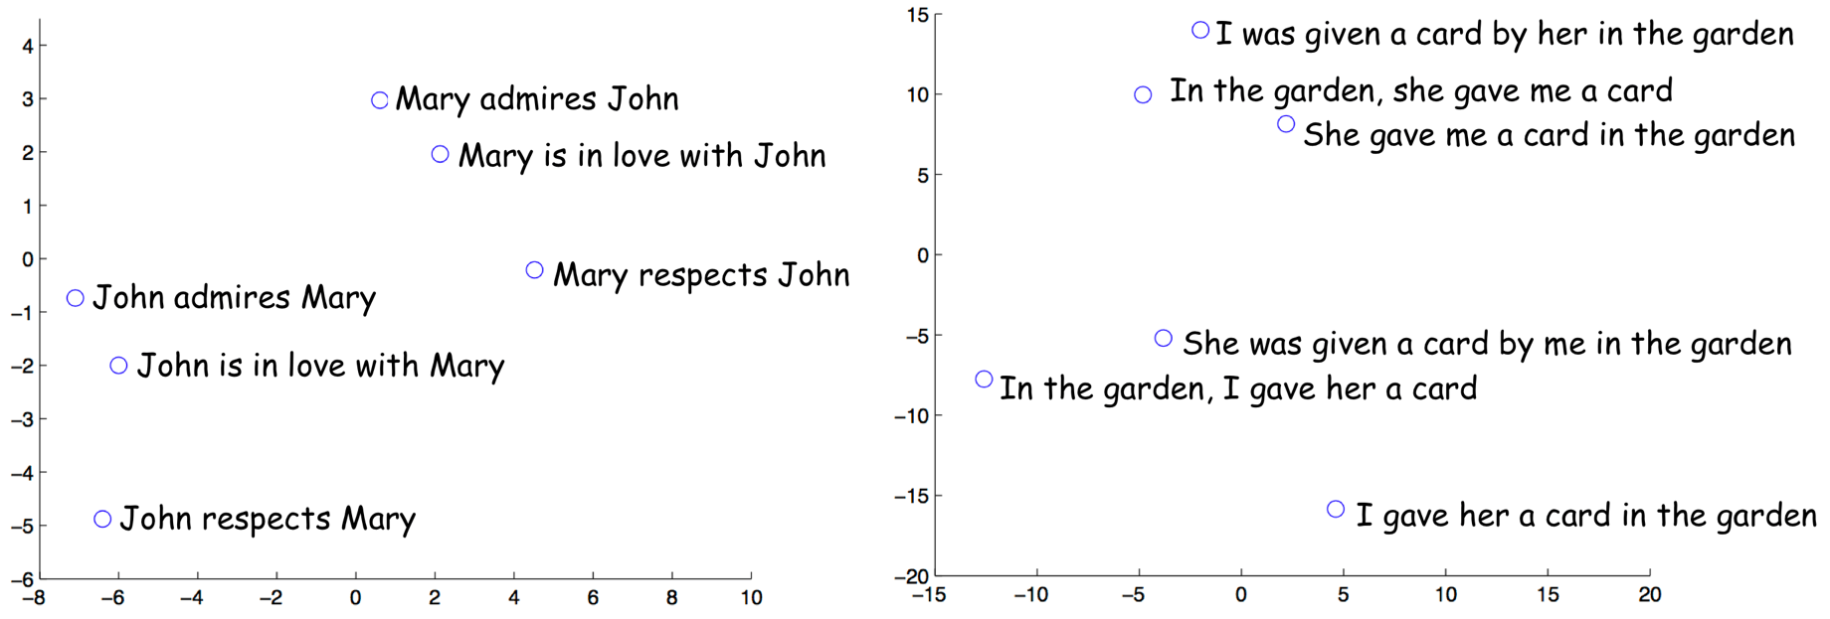
Representations of sentences with similar meaning but different structure are close!

Slide 20
Training the Two RNN Encoder and Decoder
Neural seq2seq models are trained to predict probability distributions of the next token given previous context (source and previous target tokens).
Intuitively, at each step we maximize the probability a model assigns to the correct token.

Slide 21
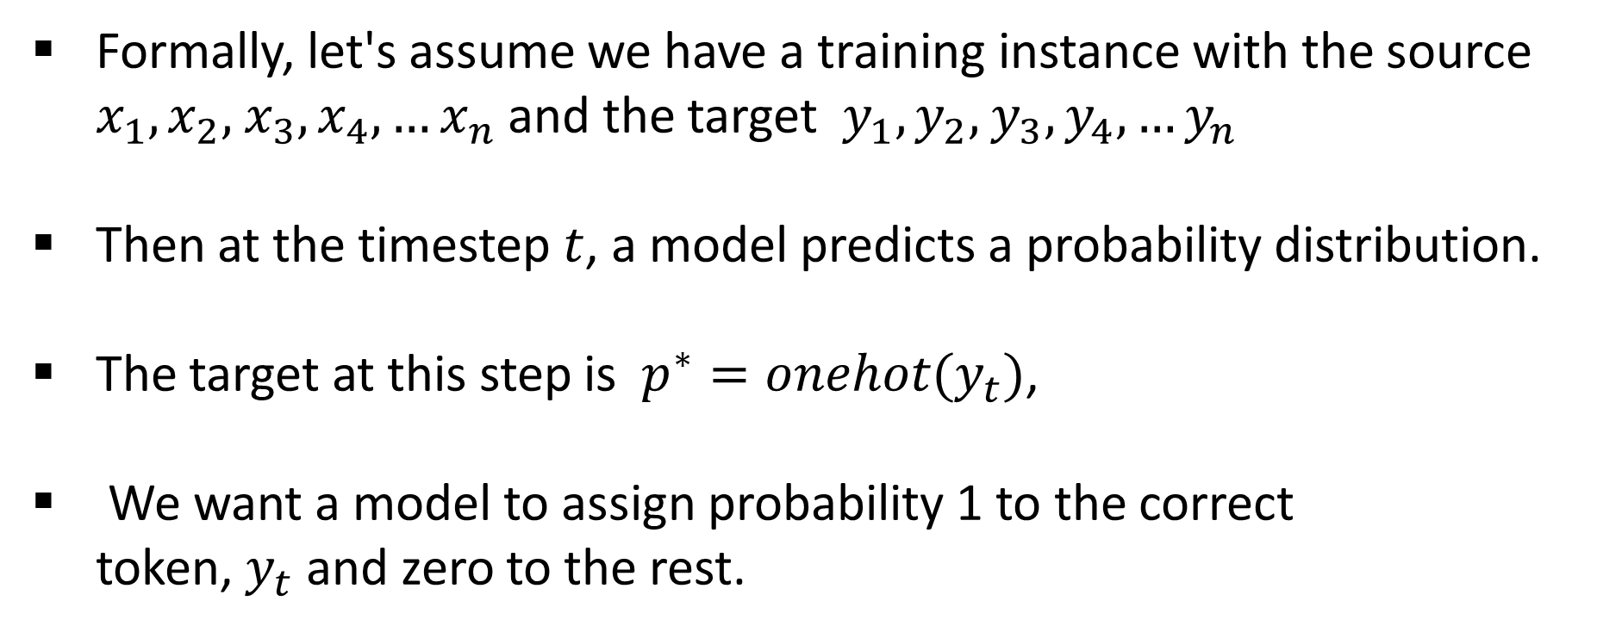
Training the Two RNN Encoder and Decoder
Formally, let's assume we have a training instance with the source $x_{1},x_{2},$ $x_{3}, x_{4}, …x_{n}$and the target $y_{1},y_{2},$ $y_{3}, y_{4}, …y_{n}$
Then at the timestep $t$, a model predicts a probability distribution.
The target at this step is $p^{∗}=onehot(y_{t})$,
We want a model to assign probability 1 to the correct token, $y_{t}$and zero to the rest.

Slide 22
Training the Two RNN Encoder and Decoder
Since only one of $p^{∗}$is non-zero (for the correct token $y_{t}$), we will get

Slide 23
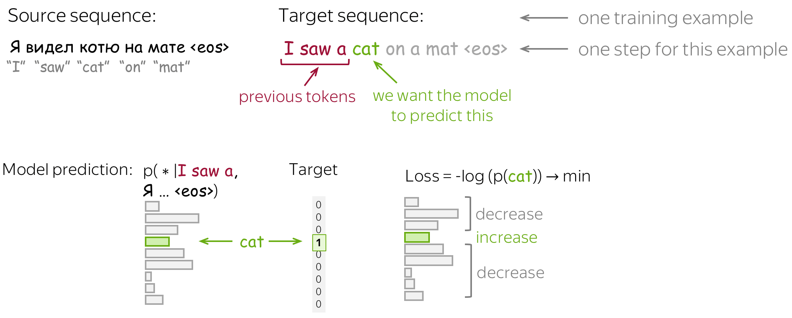

Slide 24
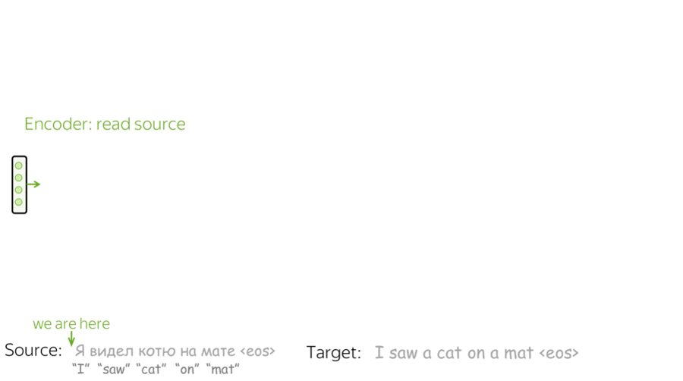

Slide 25
The Problem of Fixed Encoder Representation
In the models we looked at so far, the encoder compressed the whole source sentence into a single vector.
This can be very hard - the number of possible source sentences (hence, their meanings) is infinite.
When the encoder is forced to put all information into a single vector, it is likely to forget something.

Slide 26
The Problem of Fixed Encoder Representation
Fixed source representation is suboptimal
For the encoder, it is hard to compress the sentence
For the decoder, different information may be relevant at different steps.

Slide 27
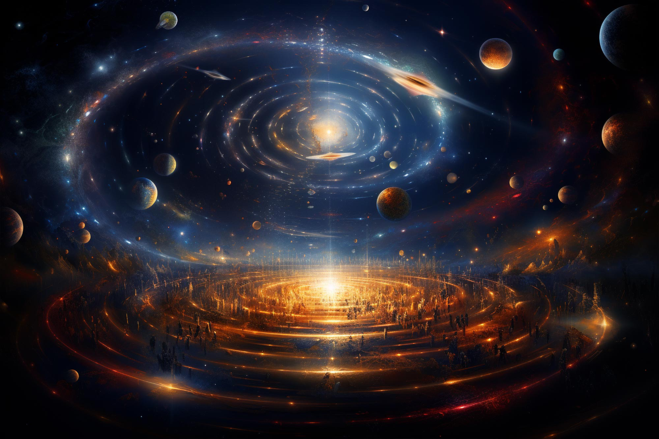
The Problem of Fixed Encoder Representation
Imagine the whole universe in all its beauty - try to visualize everything you can find there and how you can describe it in words. Then imagine all of it is compressed into a single vector of size e.g. 512. Do you feel that the universe is still ok?

Slide 28
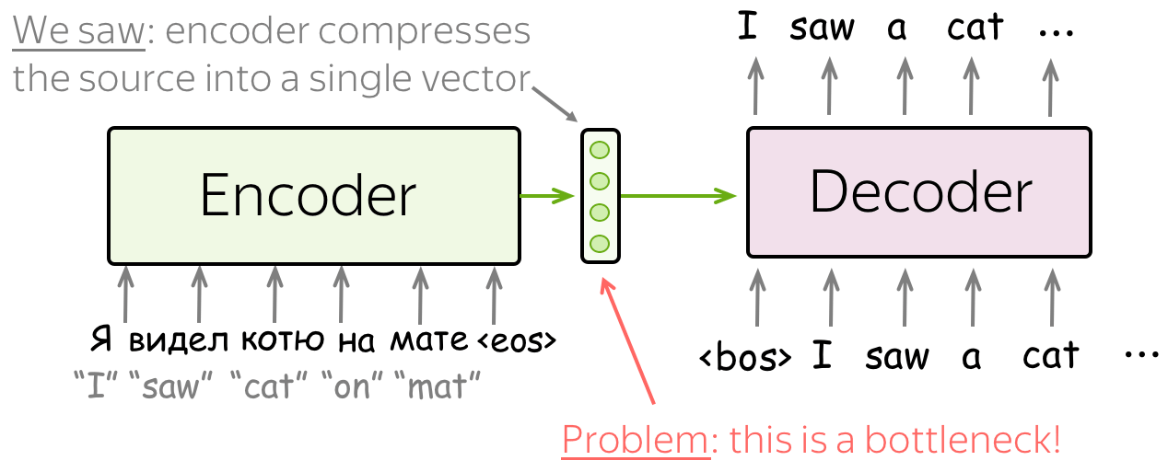
The Problem of Fixed Encoder Representation

Slide 29
Attention
Attention was introduced in the paper Neural Machine Translation by Jointly Learning to Align and Translate to address the fixed representation problem.
An attention mechanism is a part of a neural network.
At each decoder step, it decides which source parts are more important.
In this setting, the encoder does not have to compress the whole source into a single vector - it gives representations for all source tokens (for example, all RNN states instead of the last one).
Attention: At different steps, let a model "focus" on different parts of the input.

Slide 30
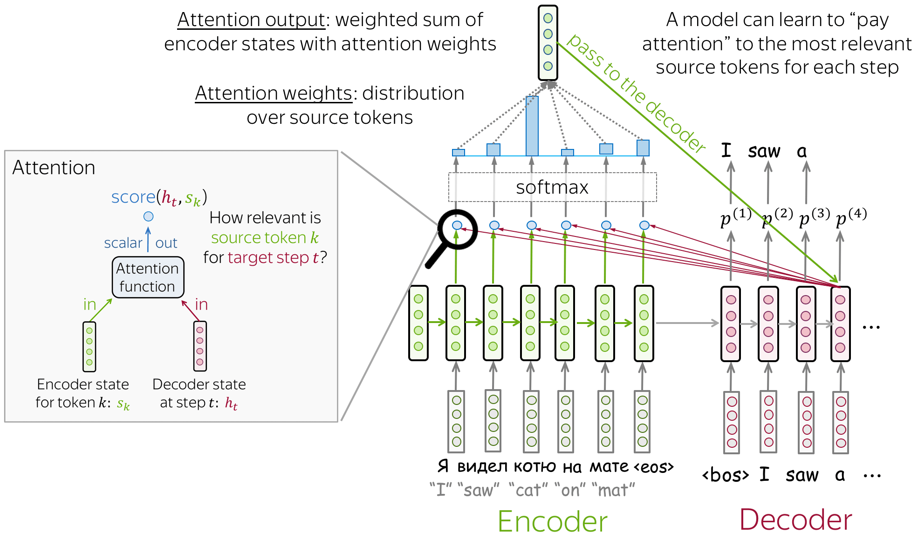

Slide 31
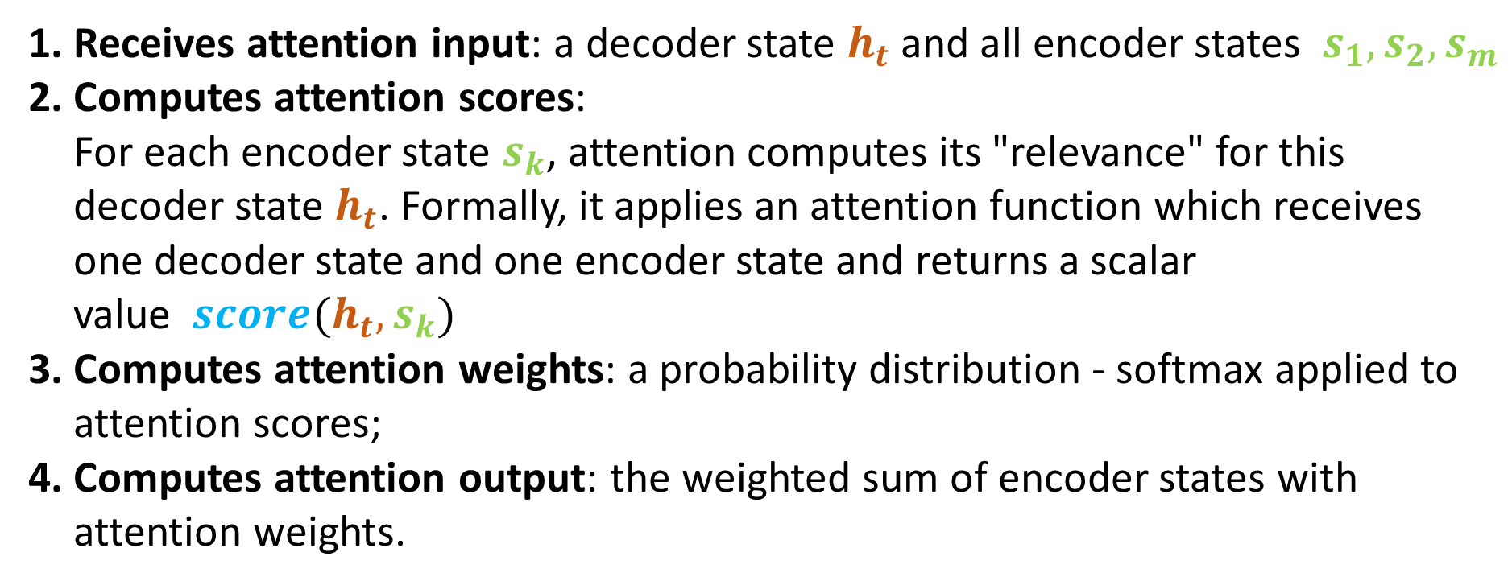
At each decoder step, attention
Receives attention input: a decoder state $h_{t}$and all encoder states $s_{1},s_{2},s_{m}$
Computes attention scores: For each encoder state $s_{k}$, attention computes its "relevance" for this decoder state $h_{t}$. Formally, it applies an attention function which receives one decoder state and one encoder state and returns a scalar value ${score(h}_{t},s_{k})$
Computes attention weights: a probability distribution - softmax applied to attention scores;
Computes attention output: the weighted sum of encoder states with attention weights.

Slide 32
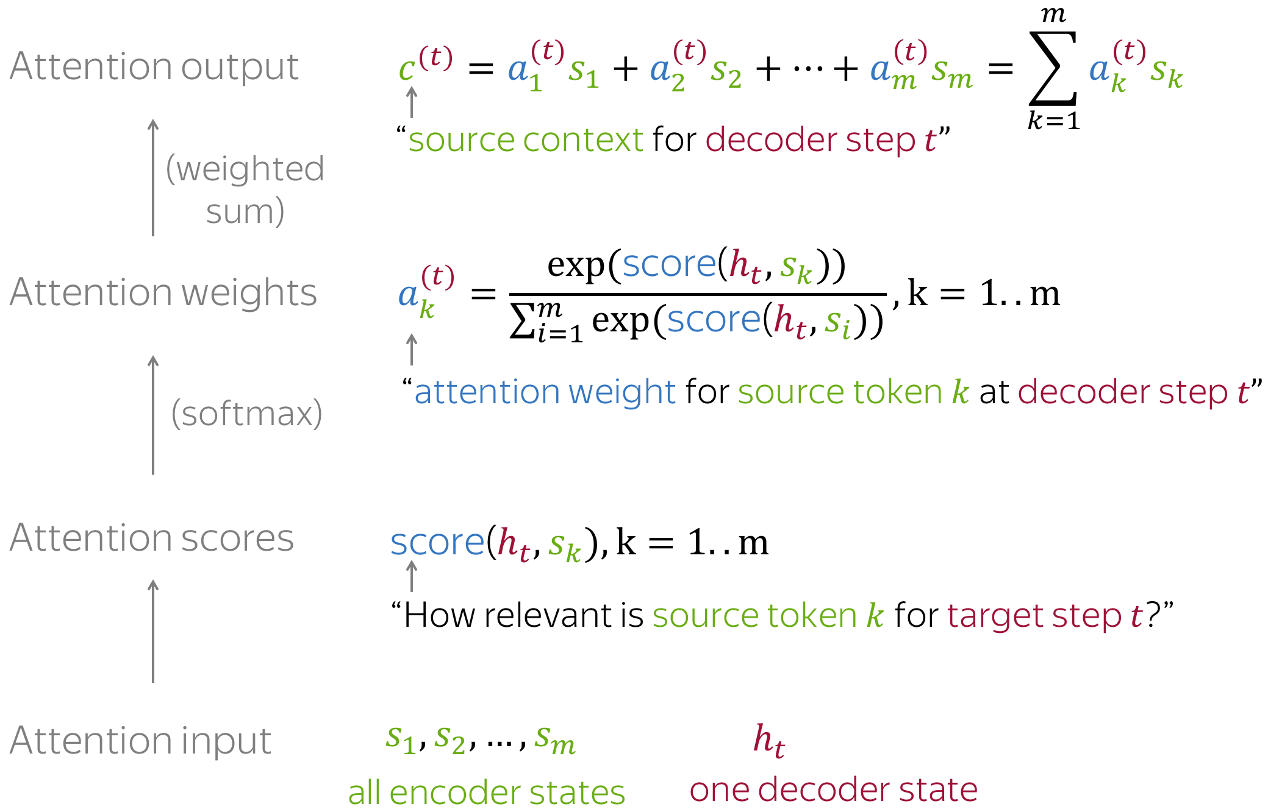

Slide 33
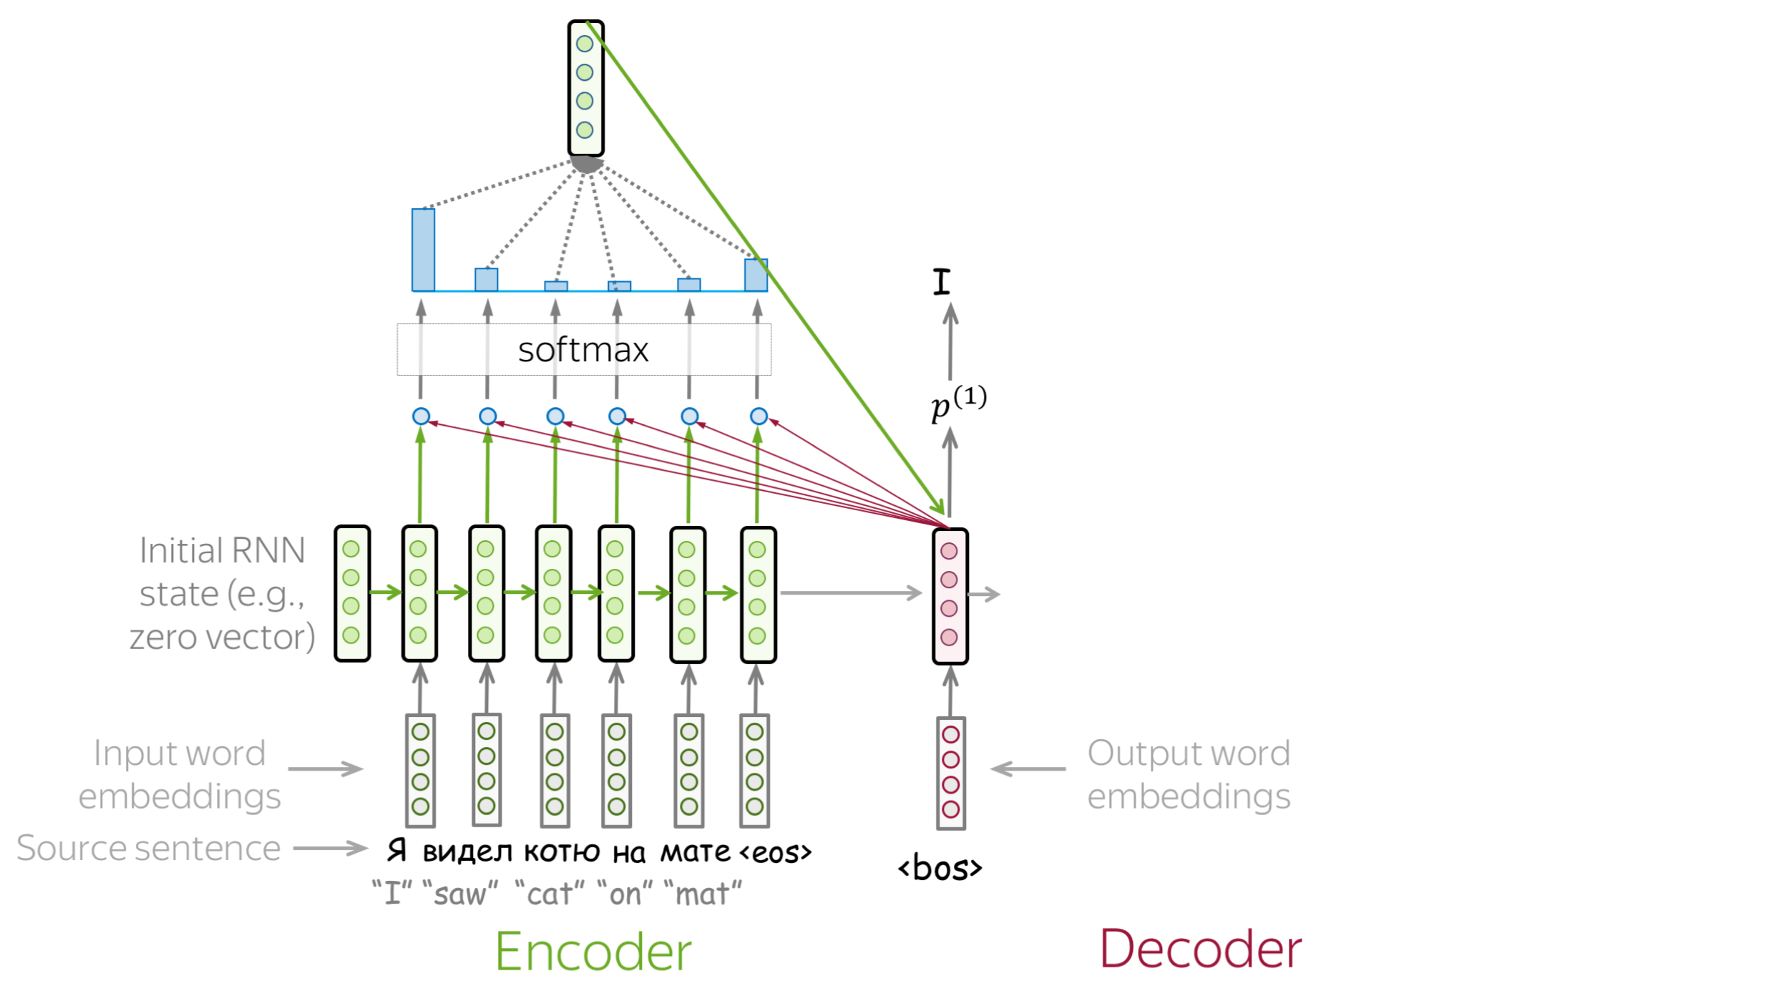

Slide 34
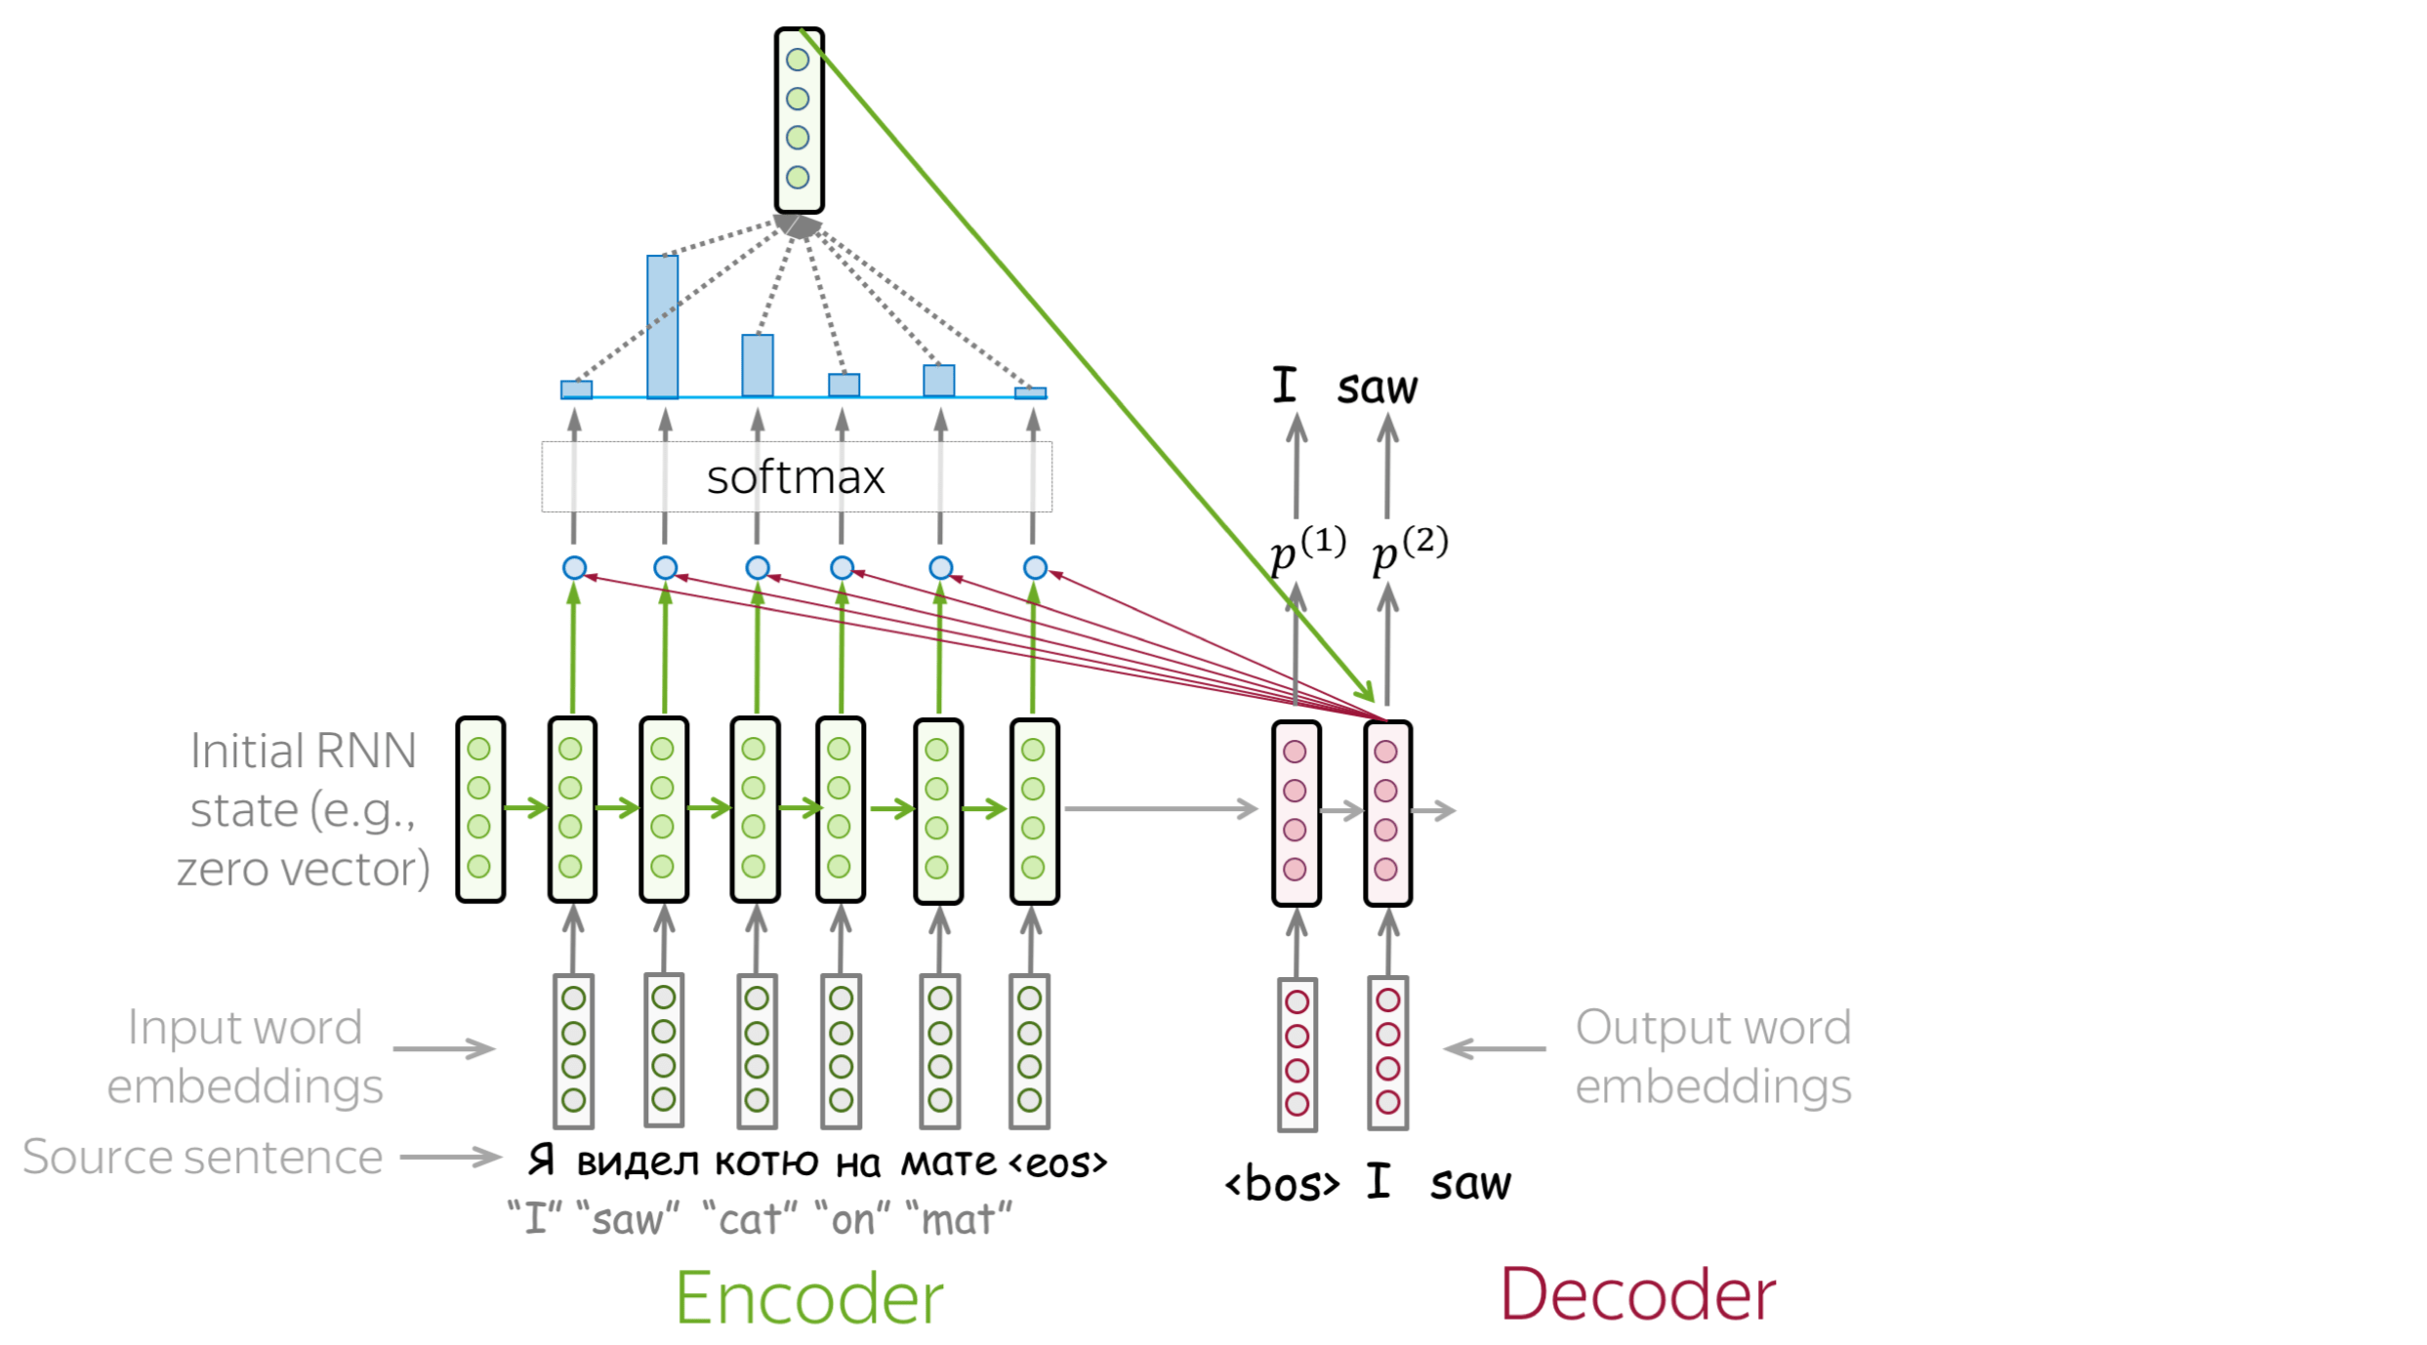

Slide 35
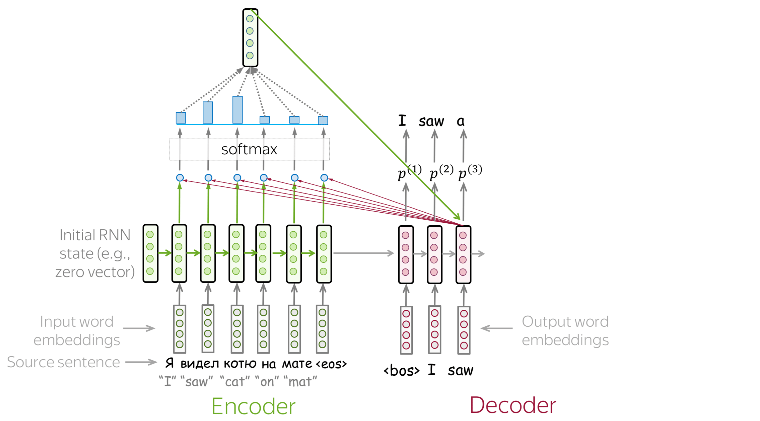

Slide 36
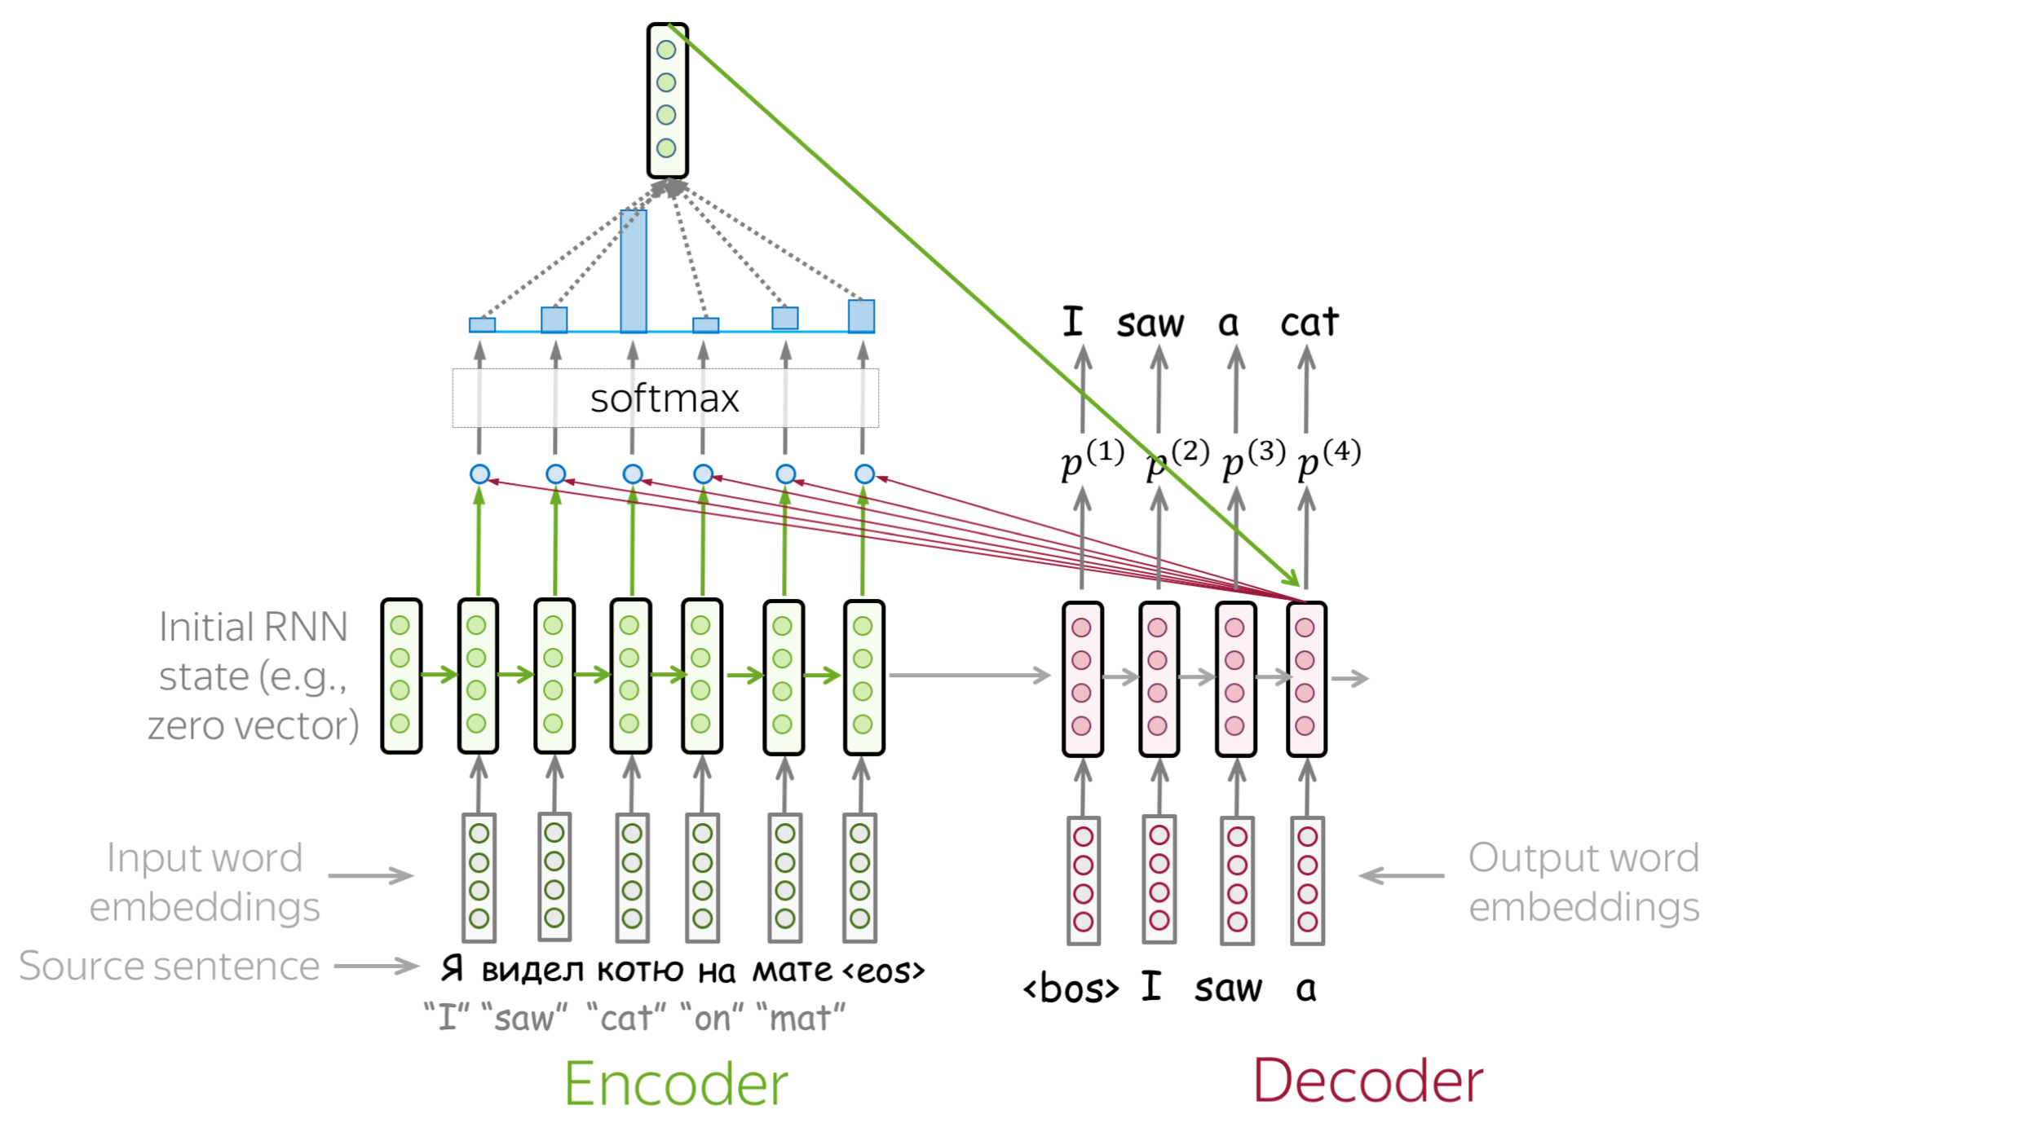

Slide 37
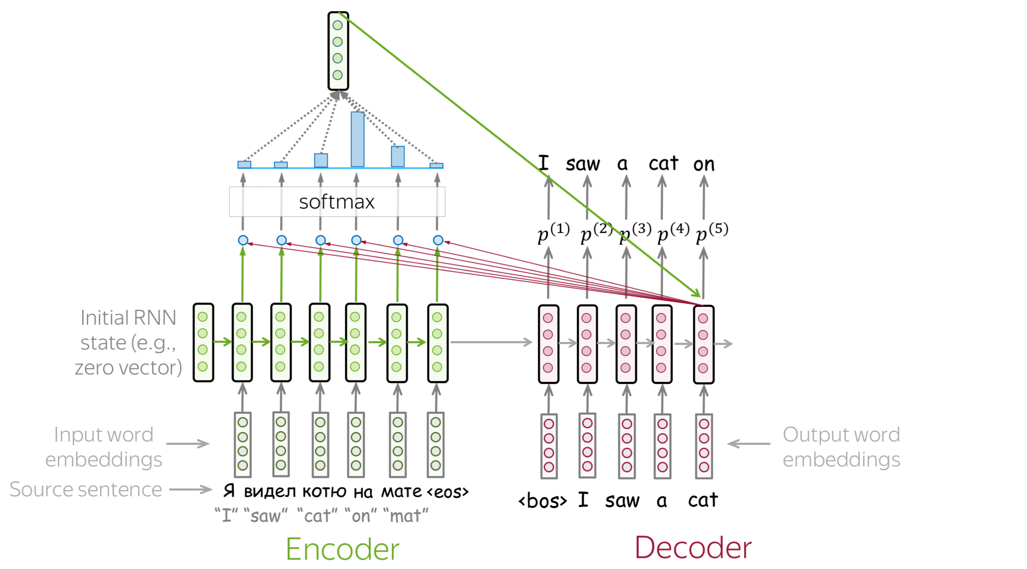

Slide 39
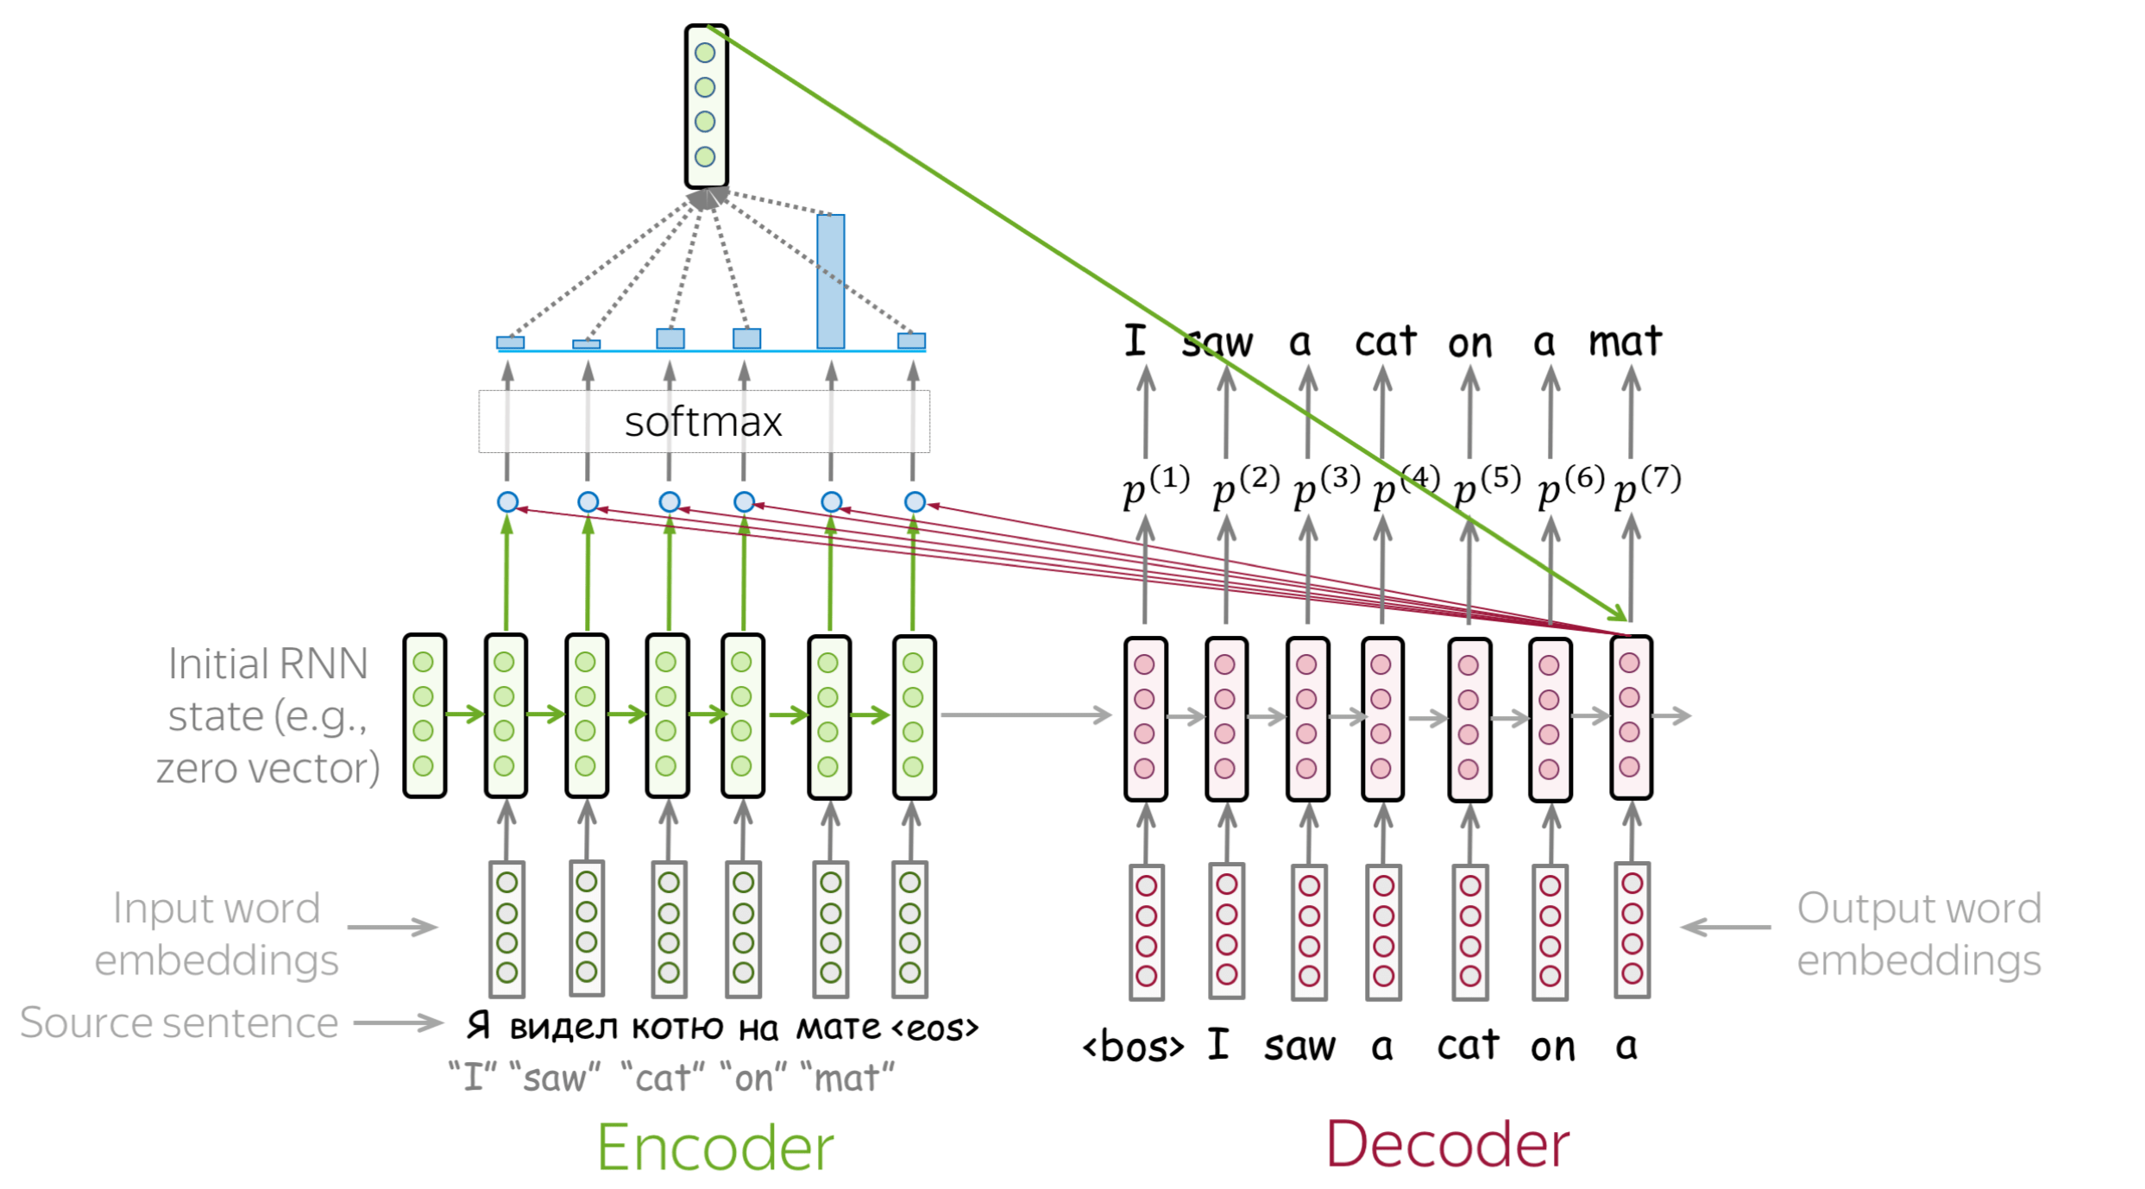

Slide 40
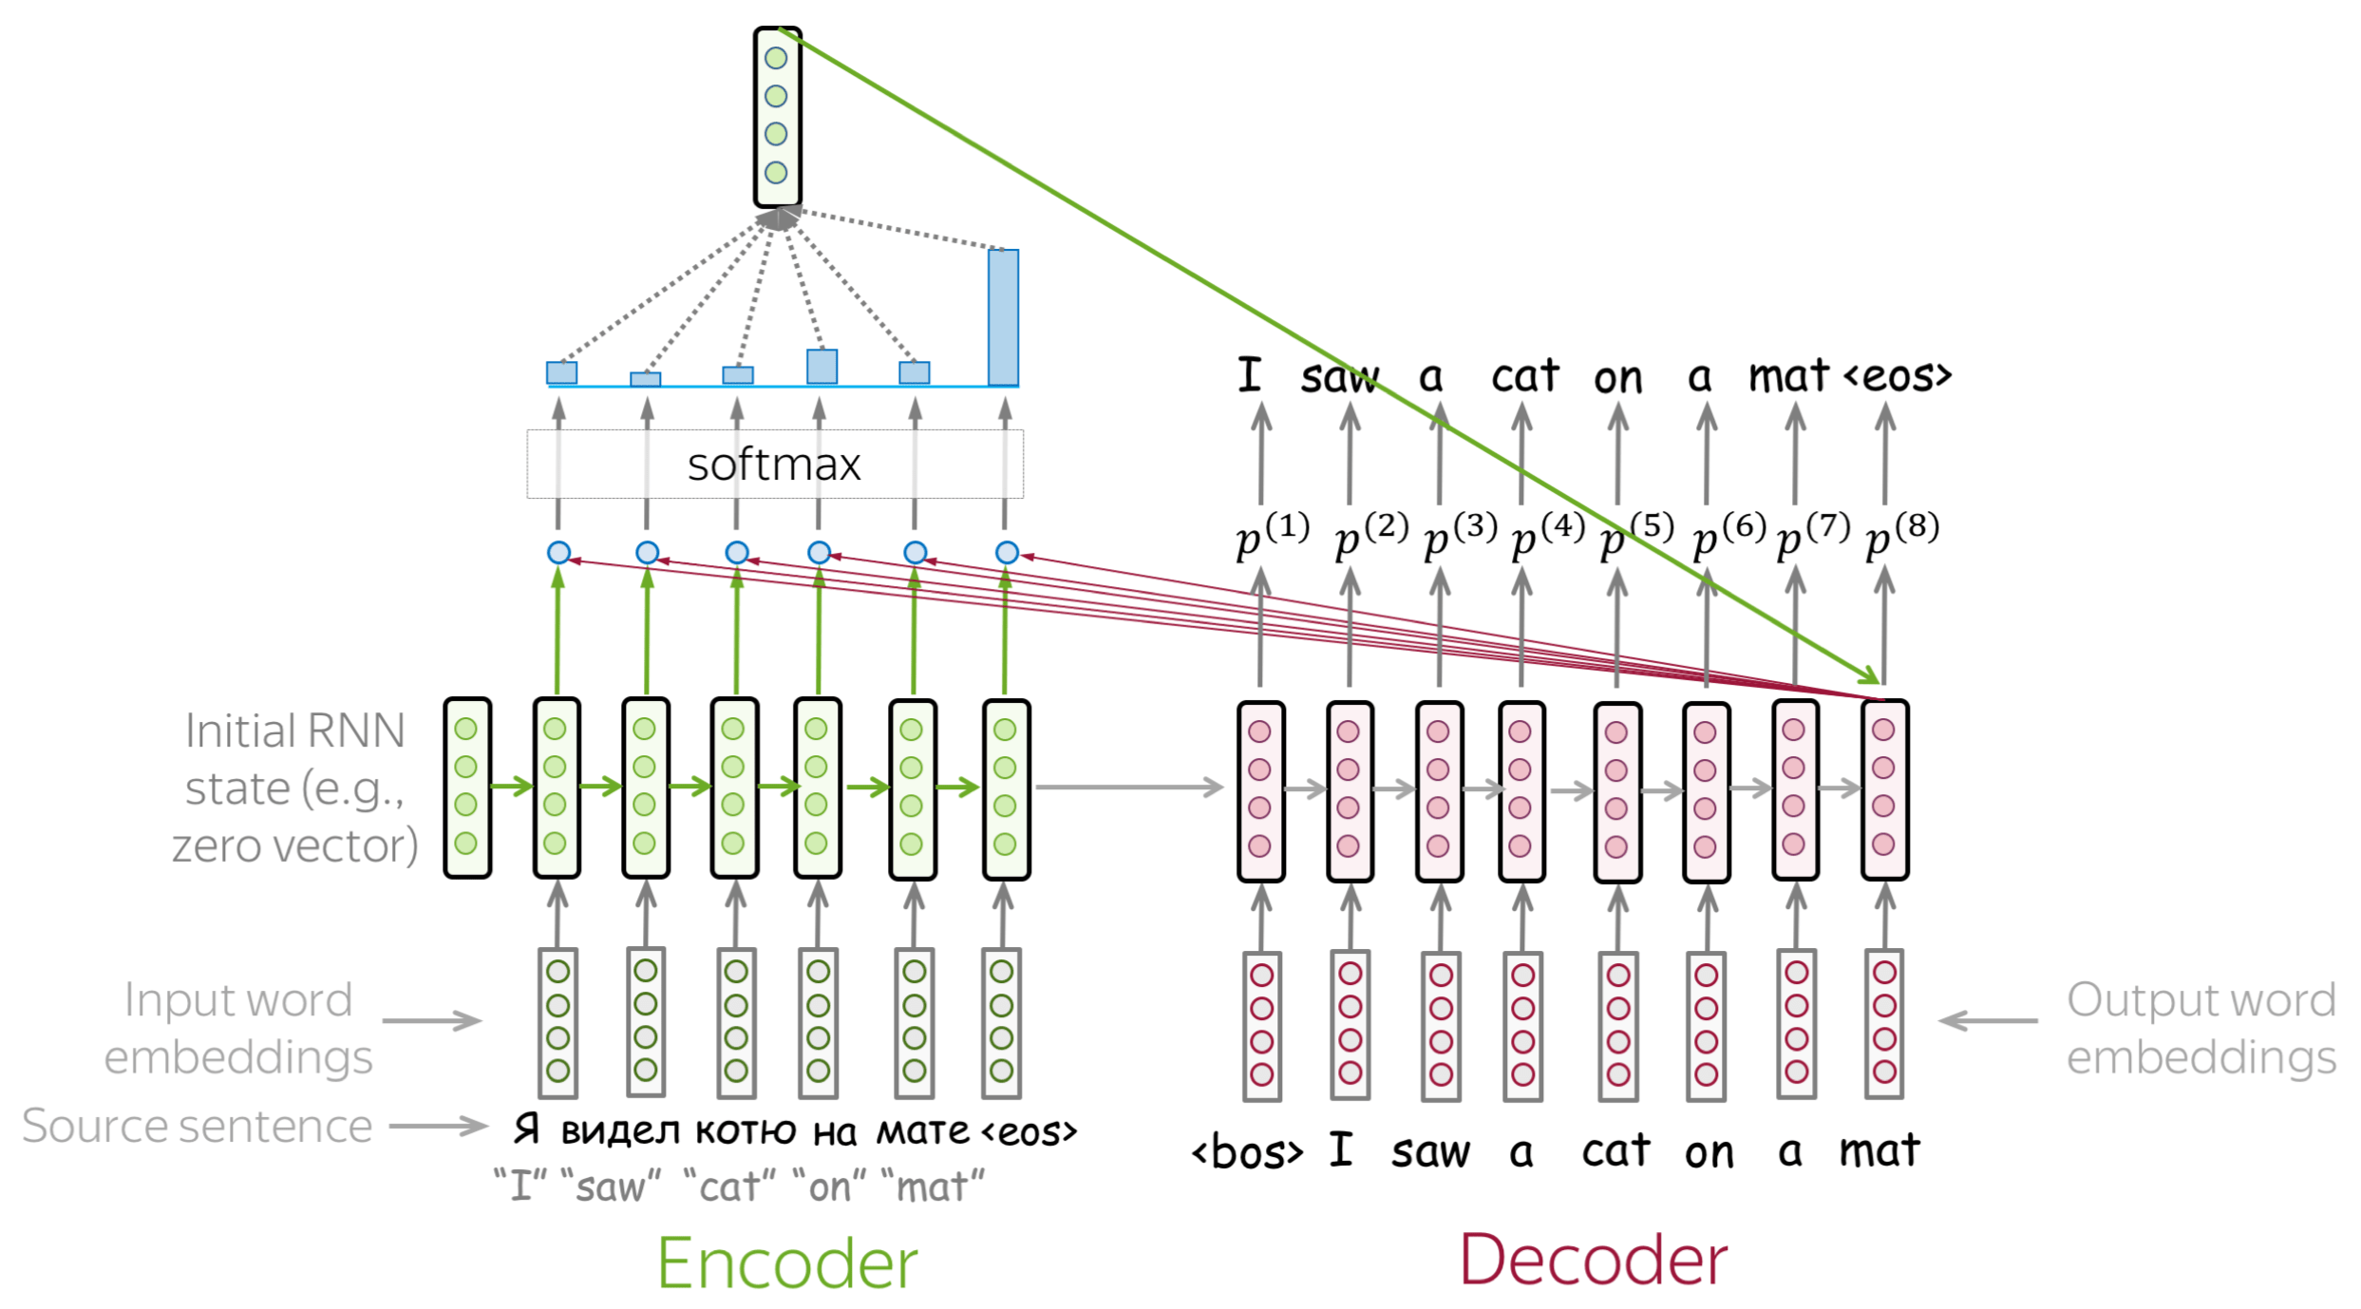

Slide 41
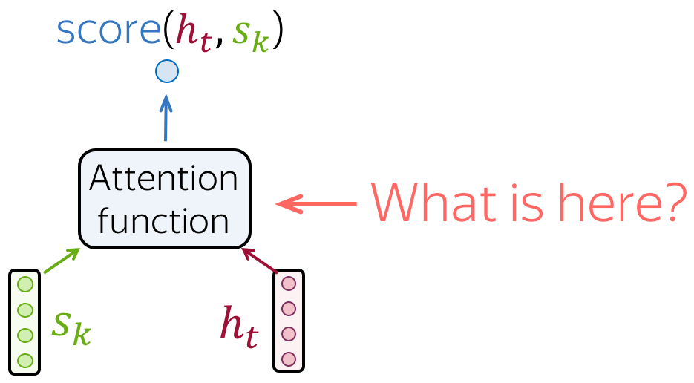
How to Compute Attention Score?
In the general pipeline above, we haven't specified how exactly we compute attention scores. You can apply any function you want - even a very complicated one. However, usually you don't need to - there are several popular and simple variants which work quite well.

Slide 42
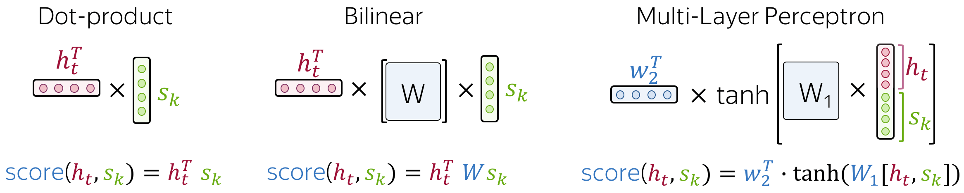
How to Compute Attention Score?

Slide 43
Attention Learns (Nearly) Alignment
Remember the motivation for attention?
At different steps, the decoder may need to focus on different source tokens, the ones which are more relevant at this step.
Let's look at attention weights - which source words does the decoder use?

Slide 44
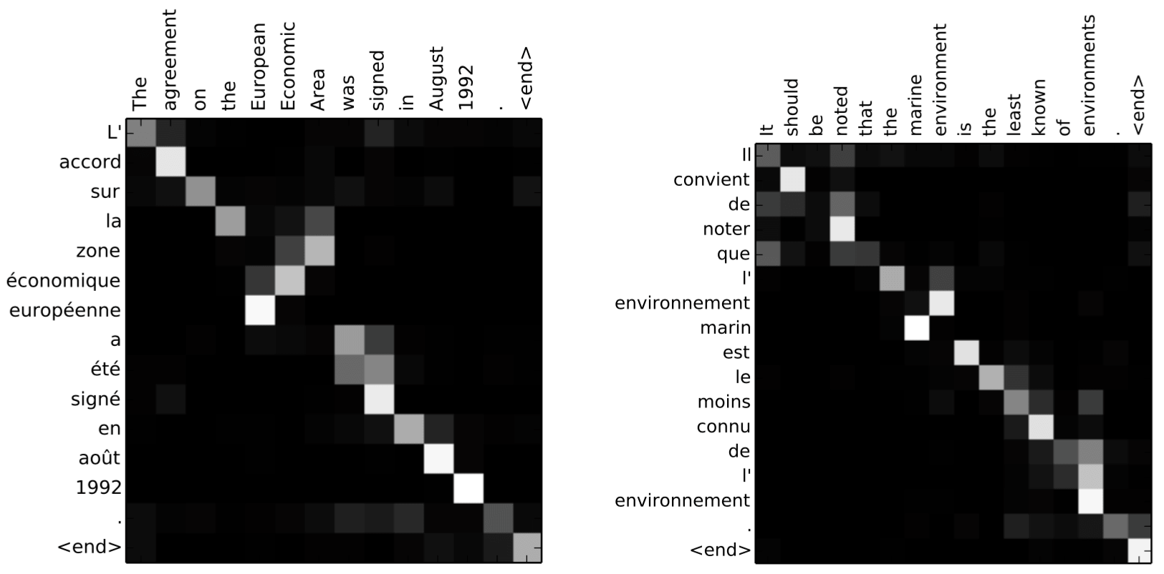

Slide 45
References
https://lena-voita.github.io/nlp_course/seq2seq_and_attention.html#main_content

